Slide 1
Hello Automation
11/29/2016
Ralph Yang

Slide 2
Session Target
Welcome And Happy Holiday
Target: Understand automation test, setup local JAVA develop environment
For Fun: Create your own AWS EC2 node, write the HelloWorld JAVA code

Slide 3
Automation Overview
What is automation test
Automation testing, which is also known as Test Automation, is when the tester writes scripts and uses another software to test the product. This process involves automation of a manual process. Automation Testing is used to re-run the test scenarios that were performed manually, quickly, and repeatedly.
Apart from regression testing, automation testing is also used to test the application from load, performance, and stress point of view. It increases the test coverage, improves accuracy, and saves time and money.
Only has one purpose: Keep best quality of our product. No difference between manual test and automation test.

Slide 4
Automation Overview
The type of test
Black box testing, White box testing, Unit testing, Integration testing, Functional testing, System testing, End-to-end testing, Sanity testing, Regression testing, Acceptance testing, Load testing..... Hundreds of them
Can check below link to see how many kinds of tests in the world:
http://www.testingexcellence.com/types-of-software-testing-complete-list/
http://www.softwaretestinghelp.com/types-of-software-testing/
If Interest, BDD testing: https://confluence.equilar.com/display/ENG/Insight+BDD+Test
What does the Automation belong to?

Slide 5
Automation Overview
How automation test become popular
<Agile Development Keywords>
Individuals and interactions over processes and tools
Working software over comprehensive documentation
Customer collaboration over contract negotiation
Responding to change over following a plan
What it means to Developers / QEs / PMs / Customers / Boss

Slide 6
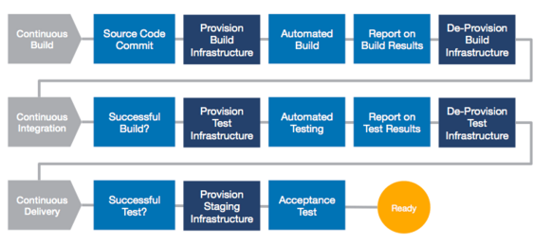
Automation Overview
How automation test become popular
<Agile Development Flow>
Where is the position for Automation test

Slide 7
What Knowledge Need To Know For Automation Test
Industry knowledge
Coding knowledge
Project knowledge
All those need to learn yourself!

Slide 8
What Knowledge Need To Know For Automation Test
Wait, then why we here?
So what will be covered in Automation practice session?
Organize your knowledge pieces by basic theory
Introduction to the common tool we use
More practice chance for real coding
Complete your own automation test in session

Slide 9
Best Practice
Develop Environment Setup
Create a free AWS windows node
Download eclipse IDE and JAVA 1.8
Install the eclipse and java, verify install success
Write a hello world and run

